Slide 1
Student Record
System
A C++ Console Application with File Persistence
Name: Aniket Mahto
Reg No.: AP24110011701
Section: J

Slide 2

Project Overview
Key Capabilities
Objective
• CRUD Operations: Create, Read, Update, and Delete records.
To develop a robust console-based application for managing student academic records. The system replaces manual tracking with a digital, automated solution.
• Data Persistence: Automatically saves data to text files.
• Safety: Robust input validation prevents crashes.

Slide 3
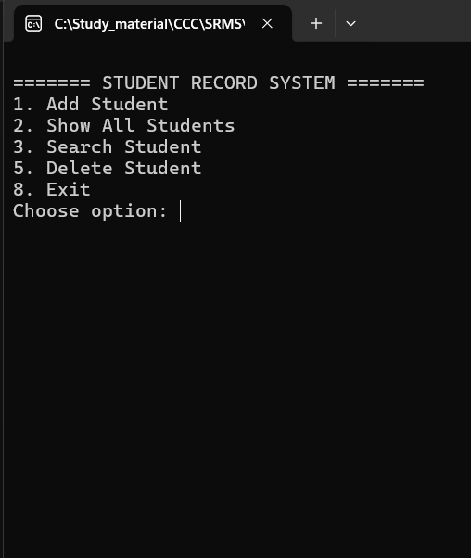
System Architecture
Class: Student
The Data Model. Responsible for capturing individual user input, formatting data for display, and handling serialization (object to string).
Class: StudentManager
The Controller. Manages the vector of students, handles all file operations (Load/Save), and serves as the bridge between the data and the user interface.

Slide 4





Key Features
Add Student
Search & View
Persistence
Collects detailed info (ID, Name, Major) and checks for duplicate IDs before saving to ensuring data integrity.
Allows quick lookup of specific students by unique ID and displays data in a formatted, readable table.
Uses File I/O to immediately save new records and update deleted ones, ensuring no data is lost between sessions.

Slide 5
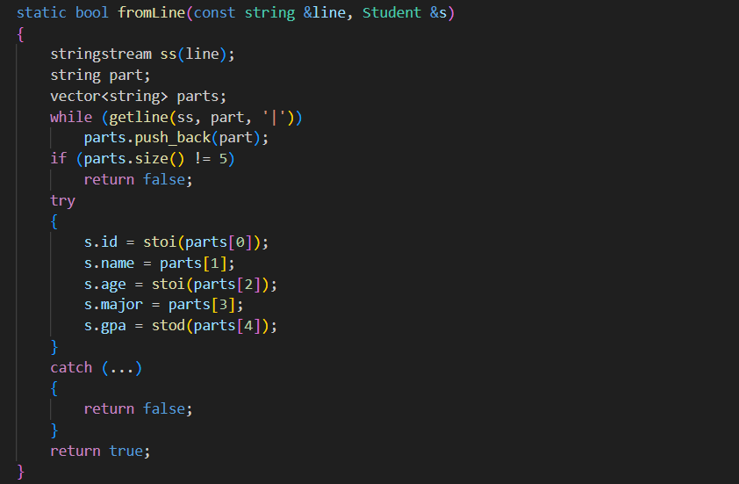
Technical Details
File Handling: Uses fstream (ofstream/ifstream) to read and write to students.txt using a pipe-delimited format.
Input Validation: Utilizes cin.fail() and numeric_limits to handle cases where users input text instead of numbers, preventing infinite loops.
Memory Management: Uses std::vector for dynamic and efficient storage of student objects during runtime.
String Parsing: Implements stringstream to parse file lines and split data by delimiters.

Slide 6




Program Execution Flow
Initialize
Menu Loop
Execute
Terminate
Program starts and StudentManager loads existing data from the text file into memory.
System displays options and waits for user choice, validating the input format.
Selected method runs (Add, Delete, Search), updating memory and the physical file.
On exit, the system ensures all final states are saved and resources are closed.

Slide 7

Conclusion & Future Scope
Future Enhancements
Summary
• Sorting: Sort records by GPA or Name.
This project demonstrates the practical application of Object-Oriented Programming (OOP) principles, efficient memory management with Vectors, and permanent data storage using standard C++ File I/O.
• Authentication: Add administrator login.
• GUI: Upgrade to a graphical interface using Qt.

